Slide 1

PRE-PROJECT DOCUMENTATION 2020
TITLE:-
CAMPUS RECRUITMENT SYSTEM
By:-
Ansh Khushboo
Kunal Shivangi
Harsimran

Slide 2

PROBLEM STATEMENT:-
Now a day, Student joins the college for better education as well as for better placement for their future. So the placement activity takes important role. In existing system all the transactions are done manually. Fake entries can be there system is more error- prone & time consuming. Difficulty in managing data of students. Large files of records are to be maintained. Placement Officer has to collect the information of various companies who want to recruit students and notify students time to time about them. It is a time consuming activity of managing, updating and informing specific student for specific company requirements.
Therefore,our aim is to create an automated system to perform the Recruitment System Process.

Slide 3
SYSTEM INTRODUCTION:-
A college campus recruitment system that consists of a student login, company login ,TPO login and an admin login. The project is beneficial for college students, various companies visiting the campus for recruitment and even the college placement officer. The software system allows the students to create their profiles and upload all their details including their marks onto the system. The admin can check each student details and can remove faulty accounts. The system also consists of a company login where various companies visiting the college can view a list of students in that college and also their respective resumes.The admin has overall rights over the system and can moderate and delete any details not pertaining to college placement rules. The system handles student as well as company data and efficiently displays all this data to respective sides.

Slide 4
Modules:-
Campus
Recruitment
System
Student
Placement officer
Admin
Company

Slide 5
MODULES ARCHITECTURE:-
Admin
Add Company
Add
Placement
Officer
View Company
Placement
Officer
Add Students
View Companies
Send Notifications
Student Job status
Student
Create Profile
Update Profile
Apply Job
View Status
Company
Students Profile
View Notifications

Slide 6
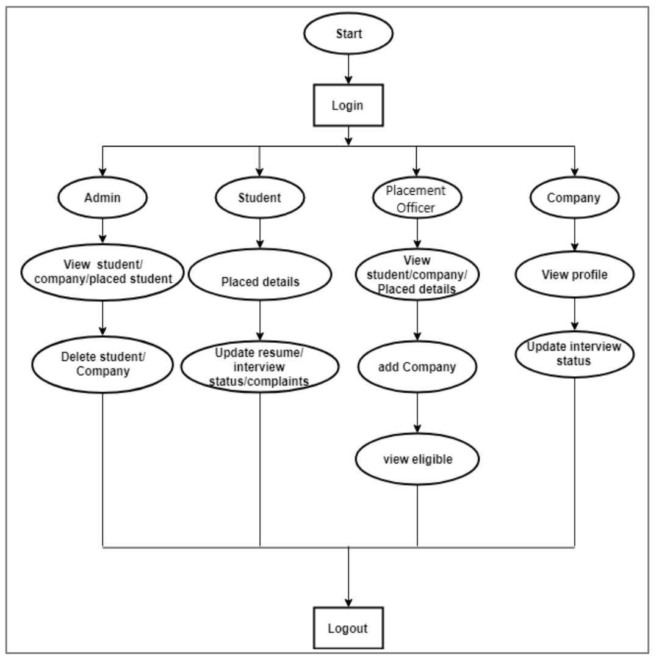
ALGORITHM FLOWCHART:-

Slide 7
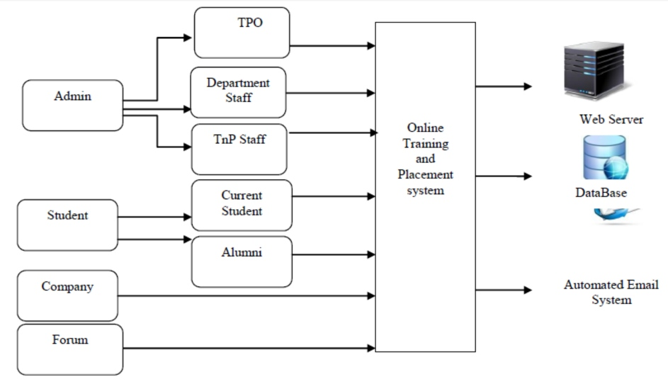
SYSTEM DESIGN:-

Slide 8
TECHNOLOGY USED:-
TECH
Front End
HTML
CSS
JAVASCRIPT
AJAX
JSP
Back End
JAVA
MYSQL DB

Slide 9

PROJECT OBJECTIVES:-
1. Reduce the paper work and create data base of student.
2. Save time & work load for TPO.
3. Easy to access.
4. Avoid fake Entry.
5. Fast and Secure data entry.
6. Improve accuracy in result.
7. User friendly interface.

Slide 10


